Slide 1
Programming Language Use in
Introductory College CS Courses
v. in Industry
***
Megan Kwok

Slide 2
Terms
“Academic languages”: programming languages taught in introductory CS courses in college/university
“Industry languages”: programming languages used in the professional computer science field

Slide 3
Background
1960s
Now
Industry languages influenced academic languages
Python, Java, JavaScript, C, C#, C++, Golang, SQL, Clojure, Typescript, Ruby, Rust, PHP, Swift, Perl, Visual Basic, MatLab, Delphi, Scratch, Racket/Scheme, NetLogo, D, etc…
Notes:
In the 1960s when the concept of computer science emerged, the programming languages that existed were limited to those used in the industry. When computer science was first established as an academic field in 1962, the languages taught were those that were used in the industry, as there were limited languages available to teach students. Students were prepared directly for entrance into the professional world of computer science.

Slide 4
Methods & Materials
Timeframe:
Industry:
Academia:
2010 - 2024
StackOverflow DevSurveys
GitHub
Google Trends
Internet Archive
survey designed and sent to professors

Slide 5
Academic Survey (Google Forms)
Languages taught
(Python, Java, C, C++, C#, Rust, Haskell, Alice, Ruby, Scala, Racket, JavaScript, others)
Paradigms followed
(Object-Oriented, Functional, Declarative, Imperative, Procedural, others)
Language effectiveness
1 10
Low High
Feedback

Slide 6
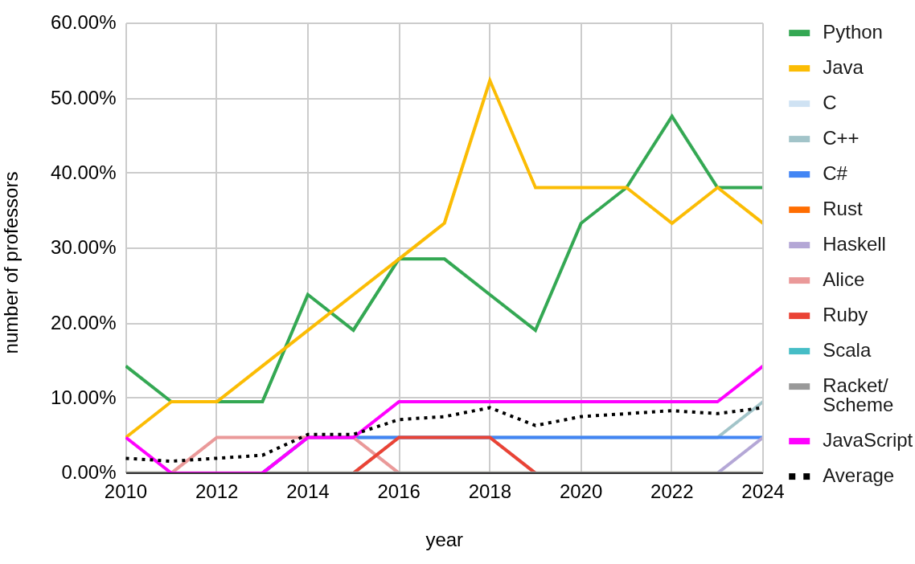
Academic Survey - Languages

Slide 7
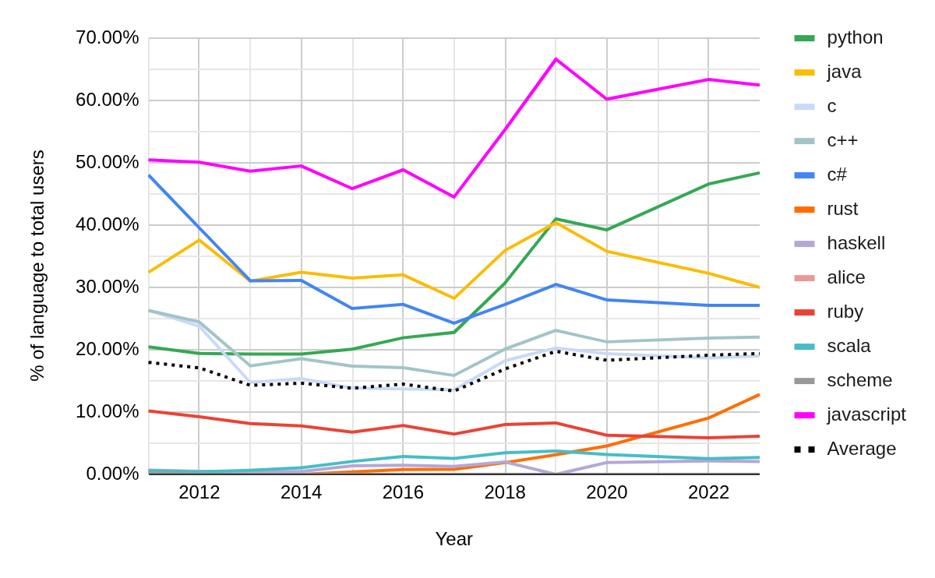
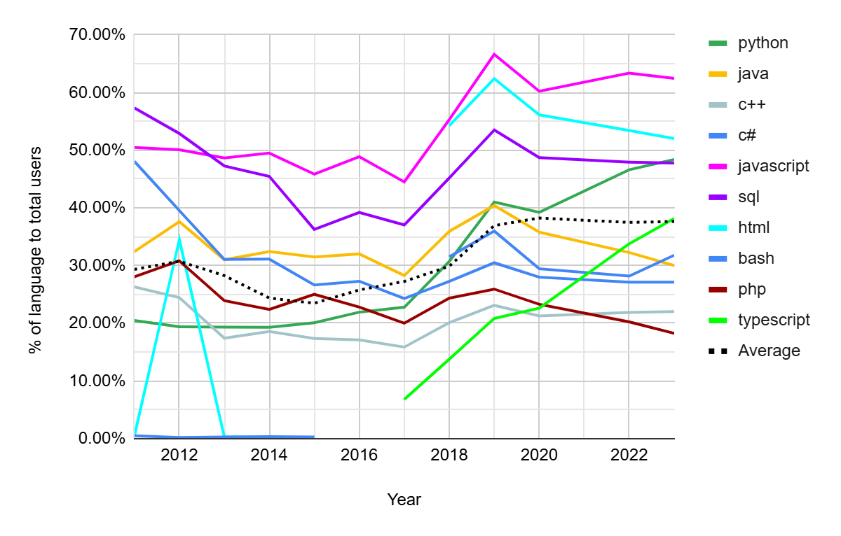
Industry
StackOverflow Developer Survey
StackOverflow Developer Survey
% of language users of each academic language
% of language users of each top 10 language

Slide 8
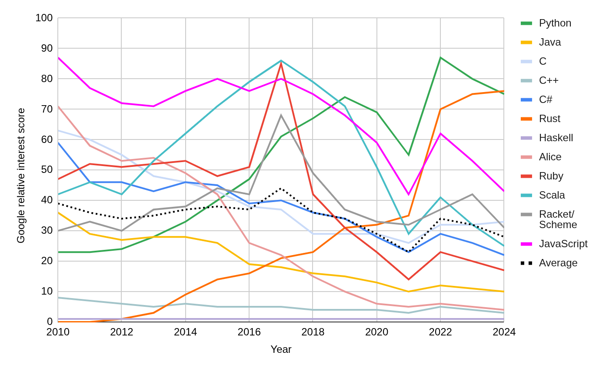
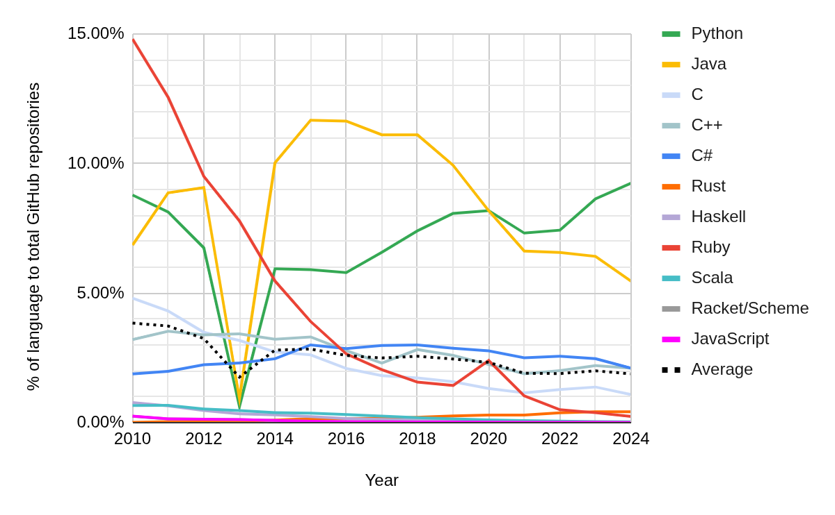
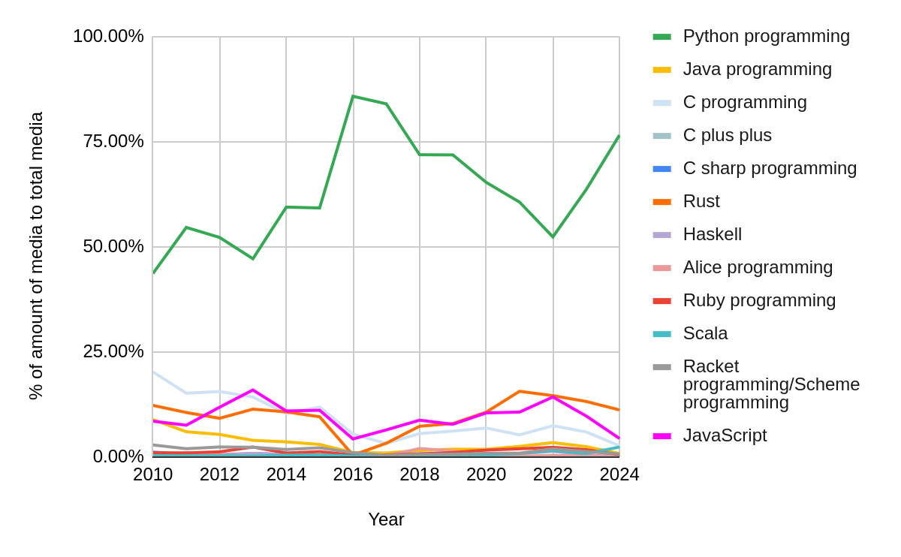
Industry
Google Trends
GitHub
Google relative interest score of each academic language
Internet Archive
% of GitHub repositories of each academic language
% of media published that involves each academic language’s keywords to total academic language media

Slide 9
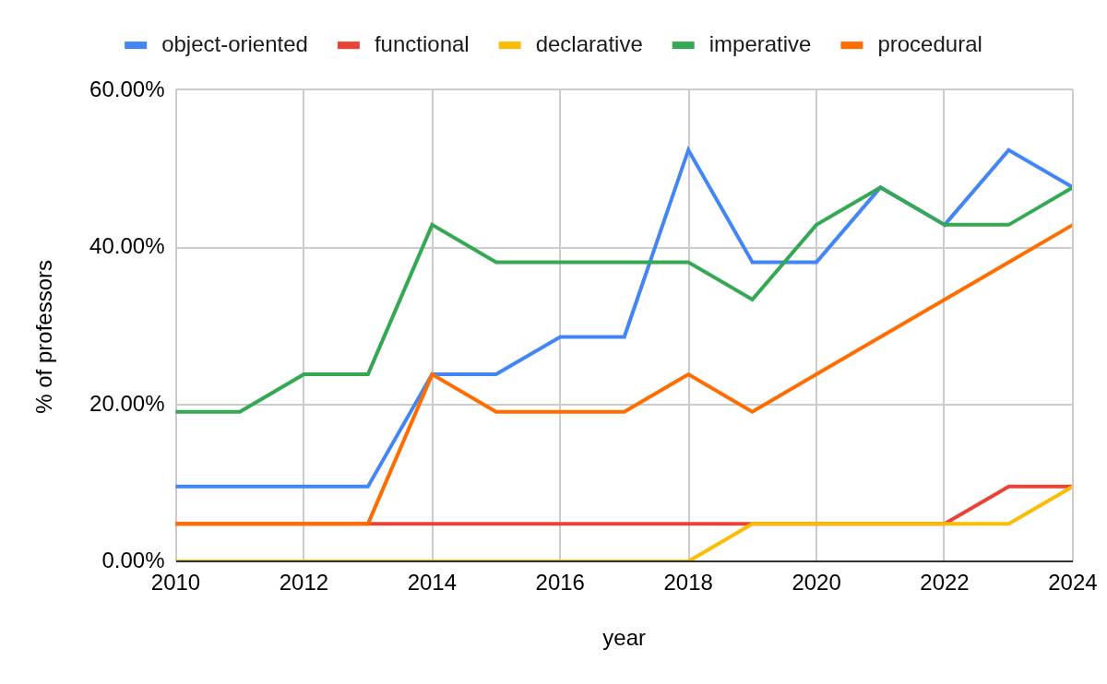
Academic Survey - Paradigms
Python, Java, JavaScript, C-family, Ruby
Haskell
SQL, HTML, Haskell
Python, Java, C-family, JavaScript
C, Pascal, FORTRAN, Basic
Notes:
Define OO-programming

Slide 10
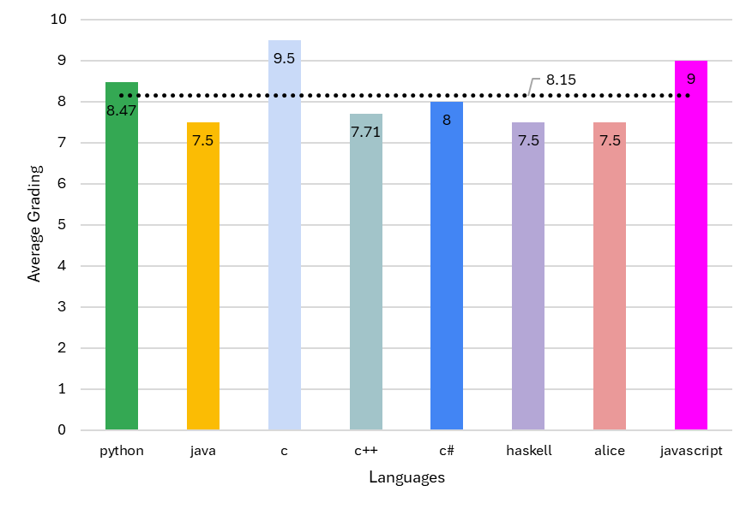
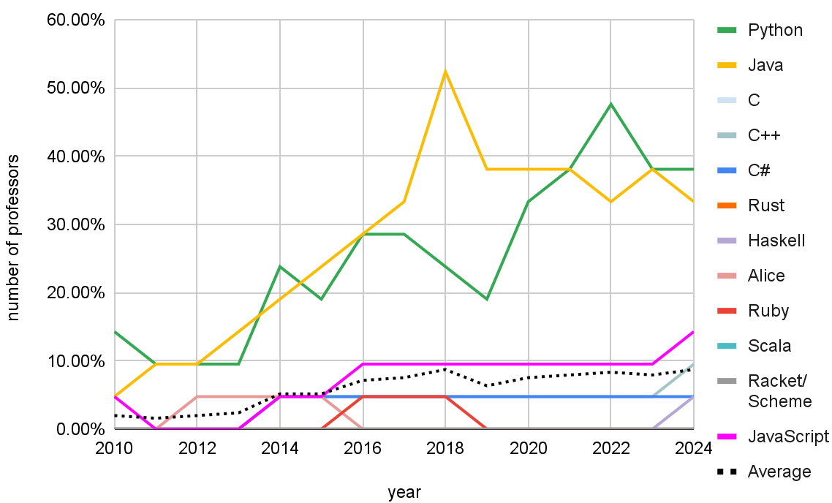
Academic Survey - Ratings
Languages taught
Notes:
Not even valuable by professors

Slide 11
Academic Survey - Feedback
“I interpreted "introductory" as: CS 1 (Python), CS 2 (Java), programming taught to math majors (Logo, then R, now Python, Sage), and programming taught to education majors (Scratch, Python, Sage)”
“We are switching from Java to C++ in the 2nd and 3rd courses of our introductory sequence.”
“Our CS1 and our intro data sciences class both use Python. ”
“The ‘must-runs’ in Java can confuse students…modern languages have curved more toward BASIC (a language developed for teaching at Dartmouth), dispensing with certain forms of syntax which constitute “extra” grammar”

Slide 12
Python, Java, JavaScript, have high usage in both industry and academia
Low learning curve
versatile
Academic Languages
GitHub
% of GitHub repositories of each academic language

Slide 13
Sources of Error
Limited curricular information available
Emailing professors
Limited industry data completeness

Slide 14
Thank you for listening!

